Slide 1
Microbiome Benchmark
Niklas Probul

Slide 2
Evaluation datasets
JPN
IND
…
ITA
JPN
IND
…
ITA
GER
Bench 1
Bench 2
‘bench_sample’
‘bench_country’

Slide 3

Federated Random Forest
1. Standard Federated RF FeatureCloud Implementation
2. Federated RF with performance weighted aggregation
https://featurecloud.ai/app/random-forest

Slide 4
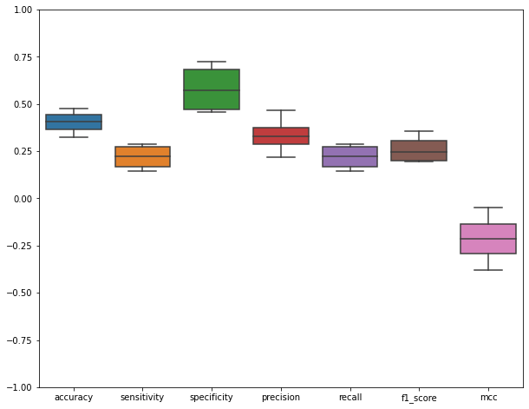
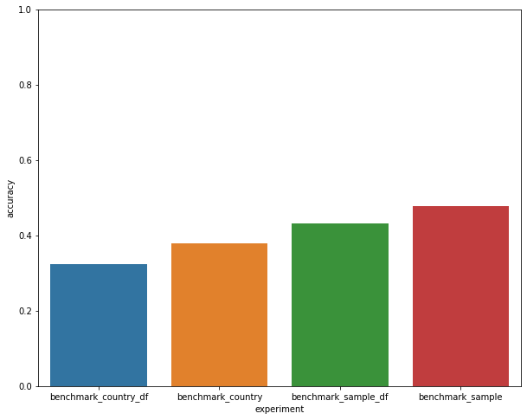
Performance

Slide 5

Performance Symbol Image

Slide 6

What’s the Problem?
Garbage IN
Garbage OUT
Great Model

Slide 7
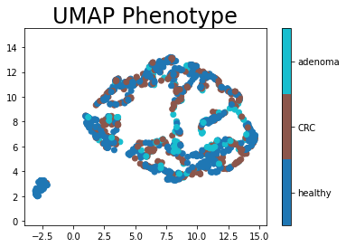
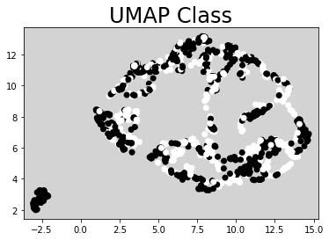
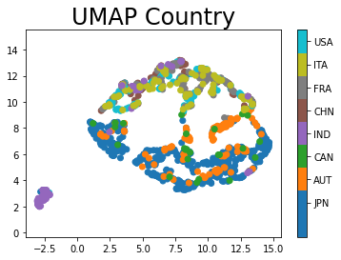
What’s the Problem?

Slide 8
What’s the Problem?
Microbiome data + Cancer + unclear Phenotype = Bad results
Hard Problem
Hard Problem
Hard Problem

Slide 9
Can we solve it?
Microbiome data + Cancer + unclear Phenotype = Bad results
Microbiomes differ, function stays!
→ include functional data
Adenoma is hard to classify
→ Remove ‘hard’ part
Hard Problem

Slide 10
Can we solve it?
Microbiome data + Cancer + unclear Phenotype = Bad results
Microbiomes differ, function stays!
→ include functional data
Adenoma is hard to classify
→ Remove ‘hard’ part
Hard Problem

